Slide 1
The Ecocentric Approach: Introducing Sustainability in Education
Valencia, Spain – May 4 – 11, 2025

Slide 2
What is it?
International training promoting sustainability.
Provided by Europass Teacher Academy.
Included workshops, collaborative tasks, and local exploration.
Aligned with UN Sustainable Development Goals (SDGs).

Slide 3
Our Journey
Teacher training sessions
SDG-based board game creation
Workshops on waste, pollution, and traceability
Exploring sustainable practices in Valencia

Slide 4
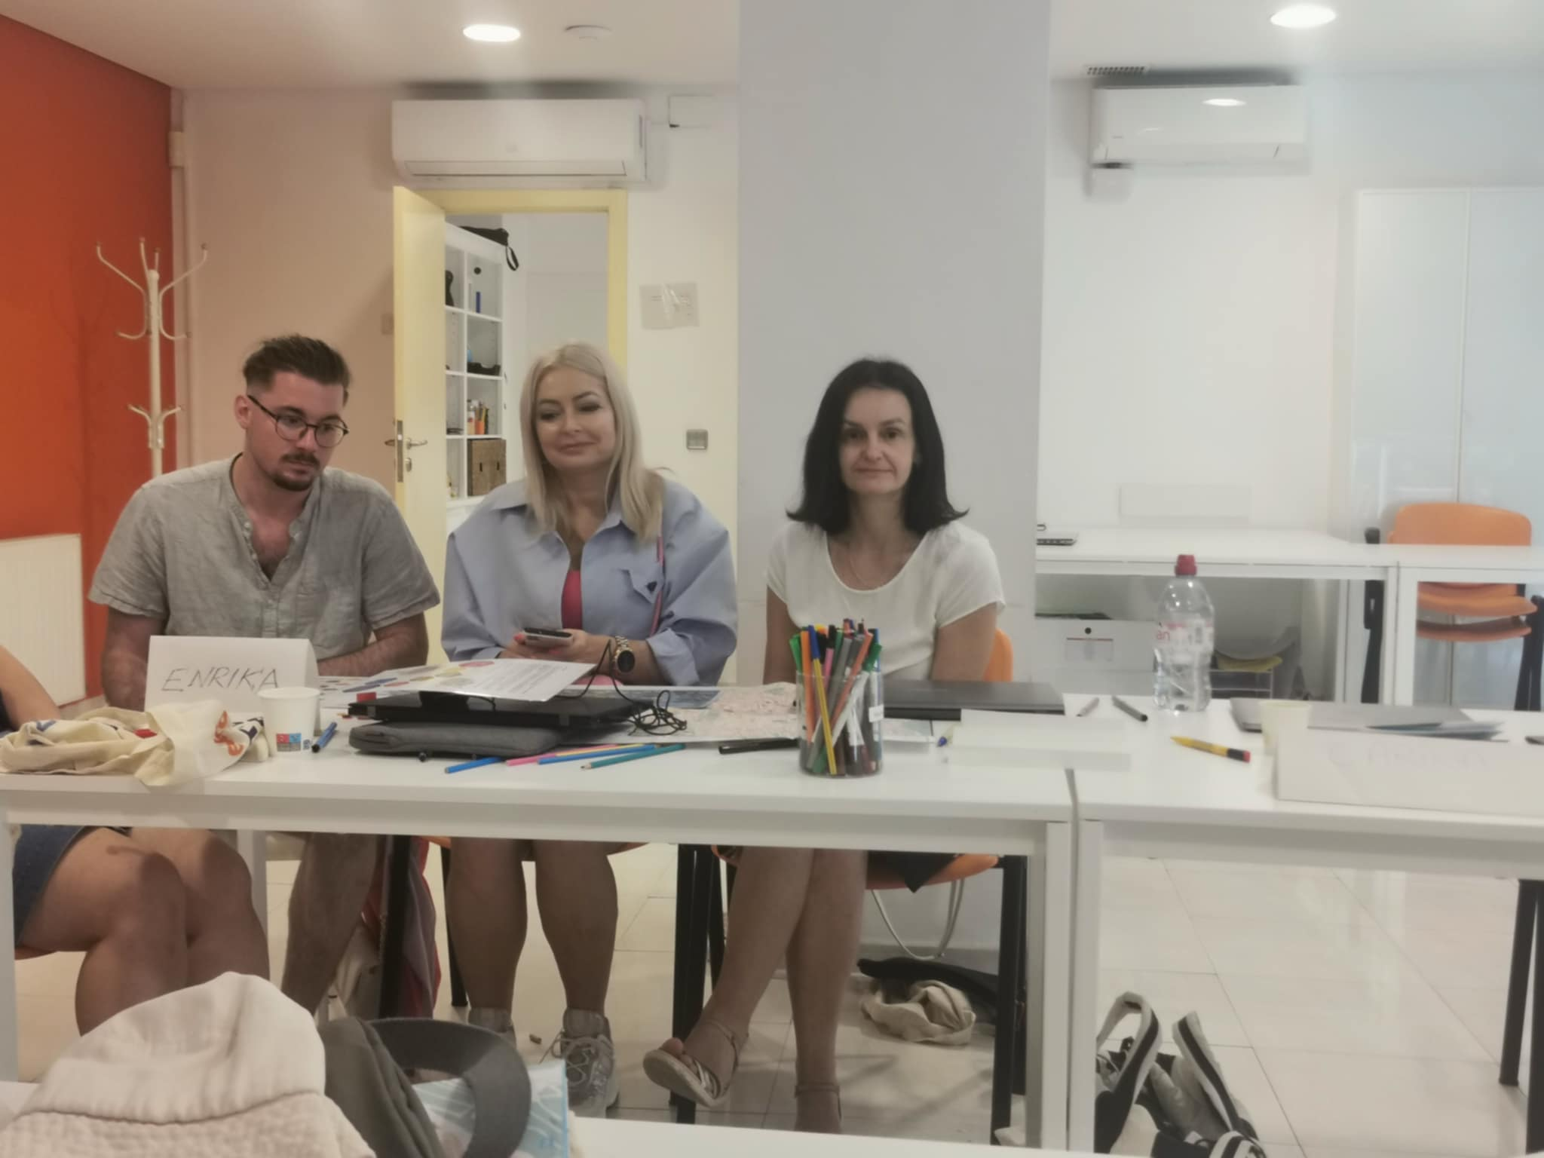
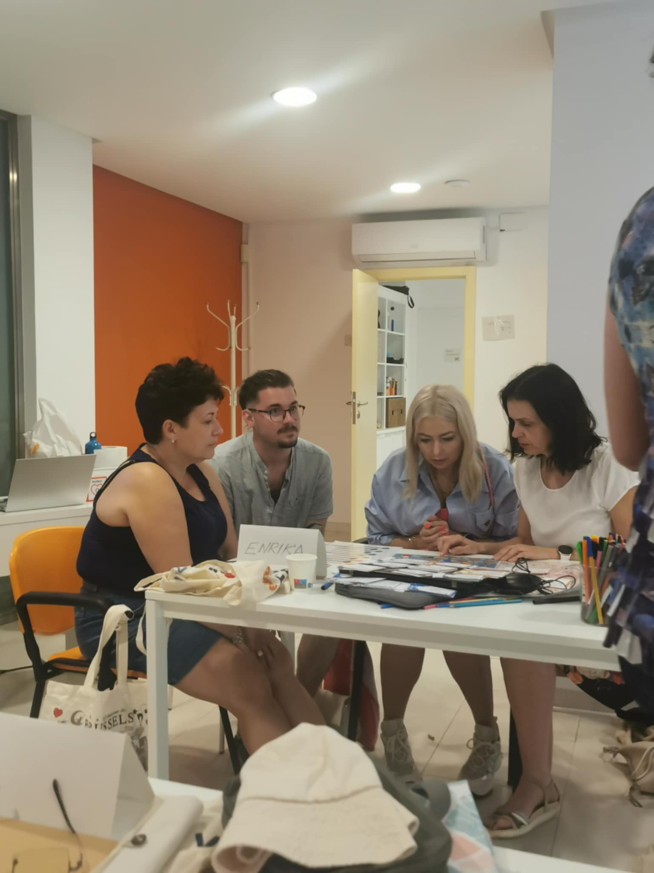
Training sessions

Slide 5
Key Learning Activities
SDG Quiz Creation
ECO Treasure Hunt
Plickers Quiz on Sustainability
Traceability Activity: 'What Are You Wearing?'

Slide 6
Sustainability Concepts Explored
Fast Fashion & Consumerism
Microplastics & Traceability
Upcycling vs. Downcycling
Greenwashing & Greenhushing
Permaculture & Cradle-to-Cradle

Slide 7
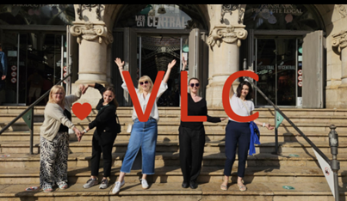
Local Exploration – Valencia Highlights
Guided tour
Local gastronomy (Paella, Horchata)
Urban gardens and permaculture
Street art on environmental themes

Slide 8
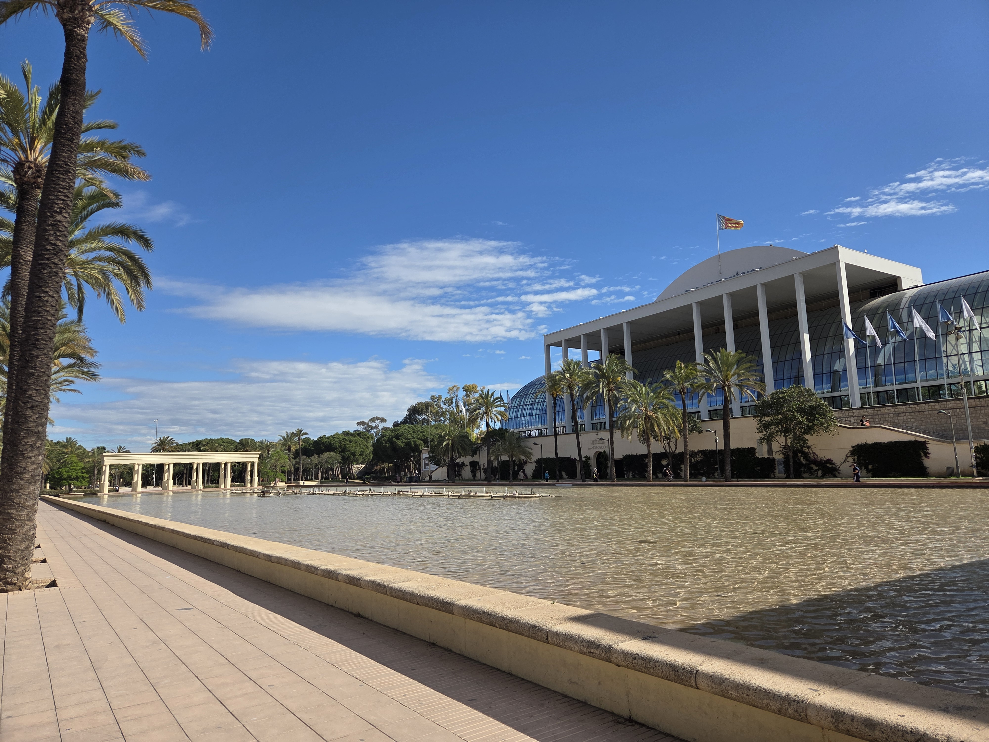
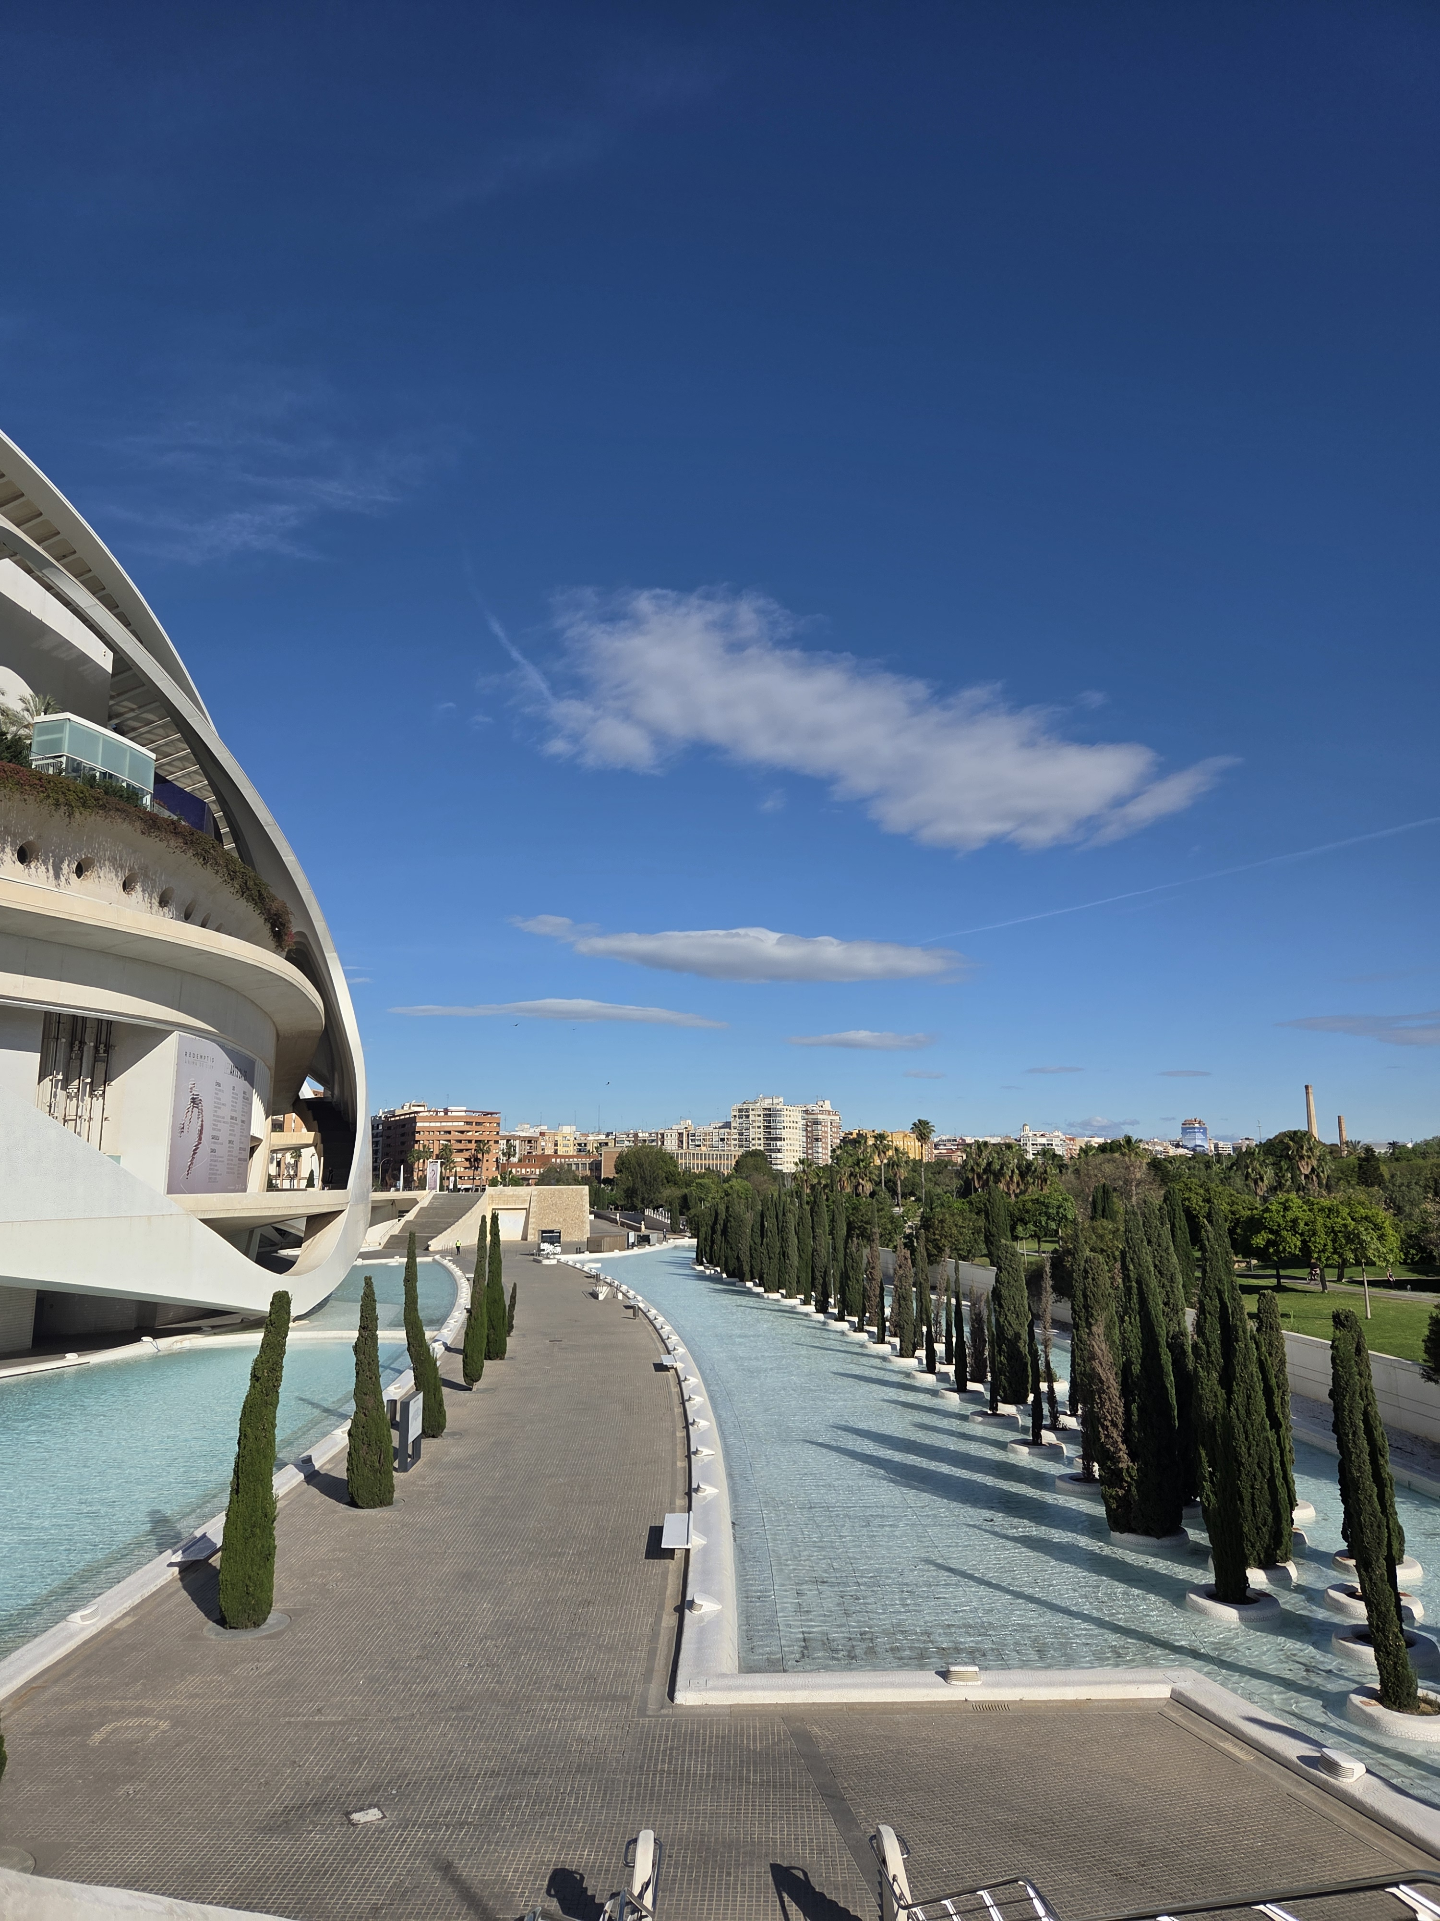
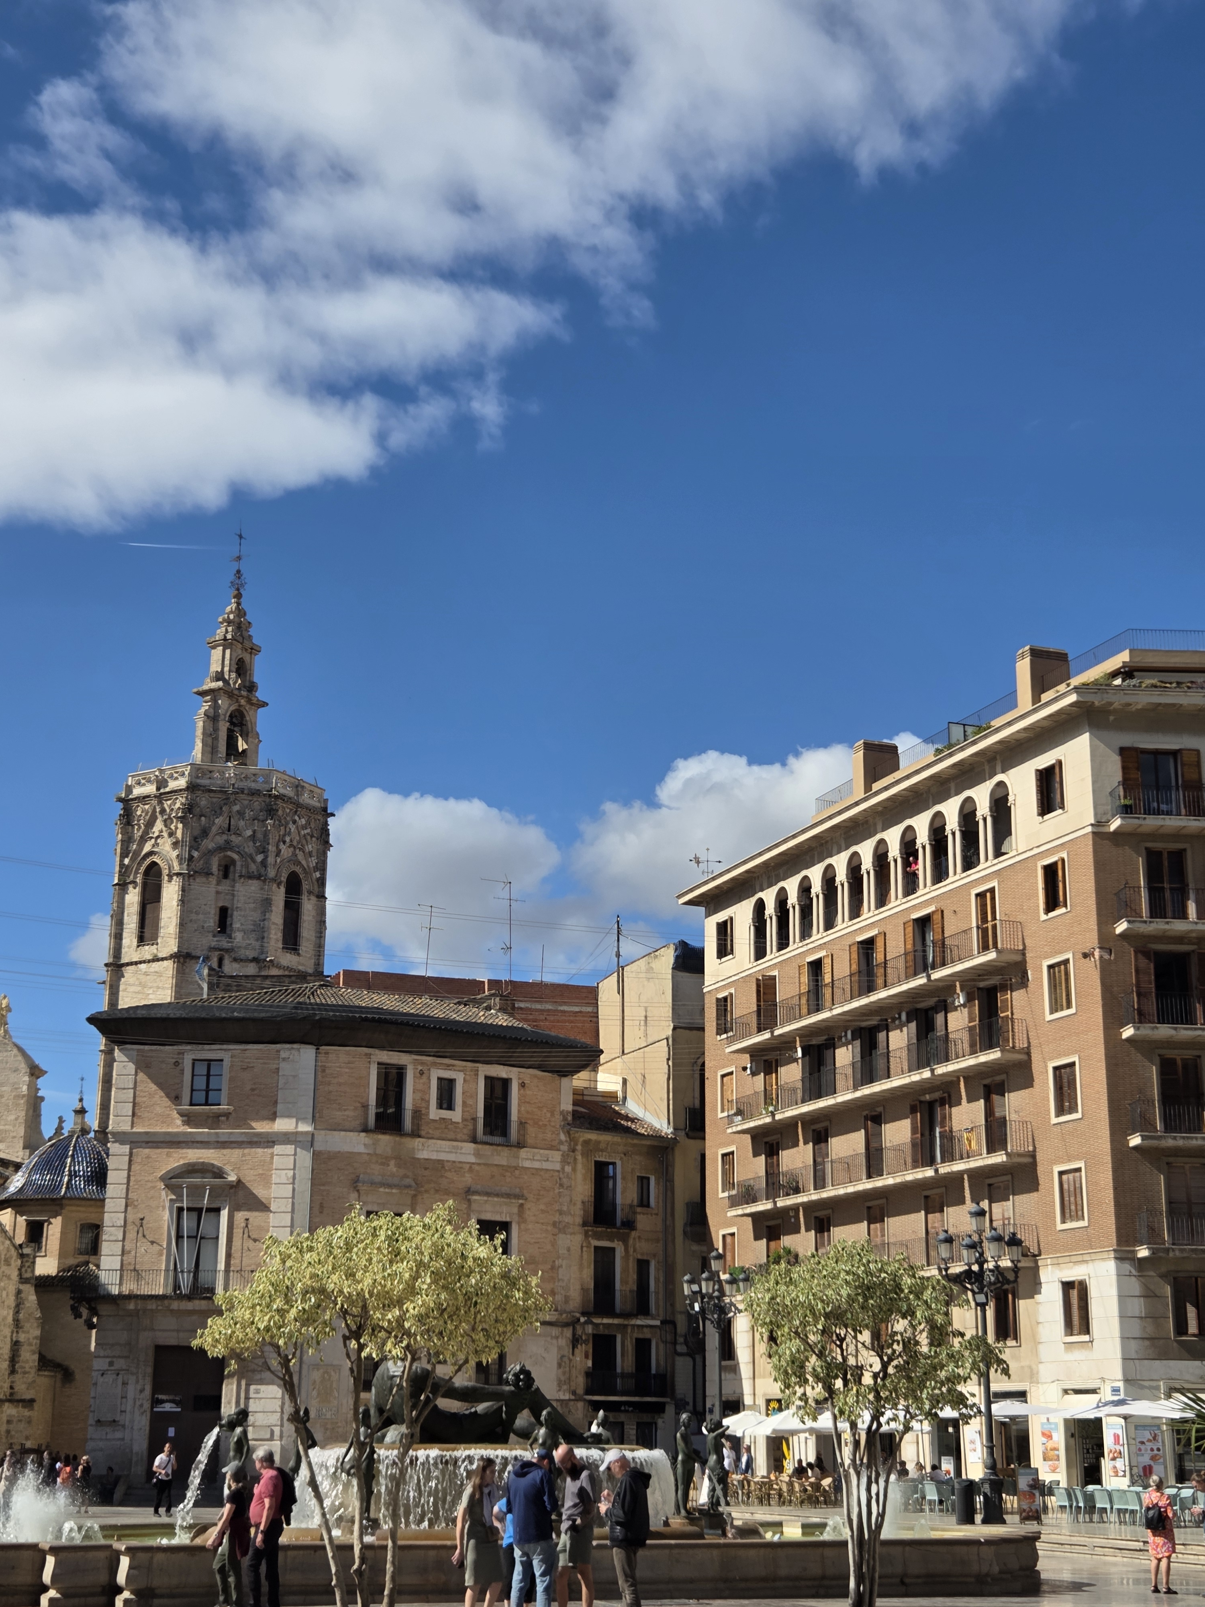
Guided TOUR

Slide 9
Student Involvement
Tasks for Primary, Lower Secondary, and Vocational students
SDG Board Game sample questions

Slide 10
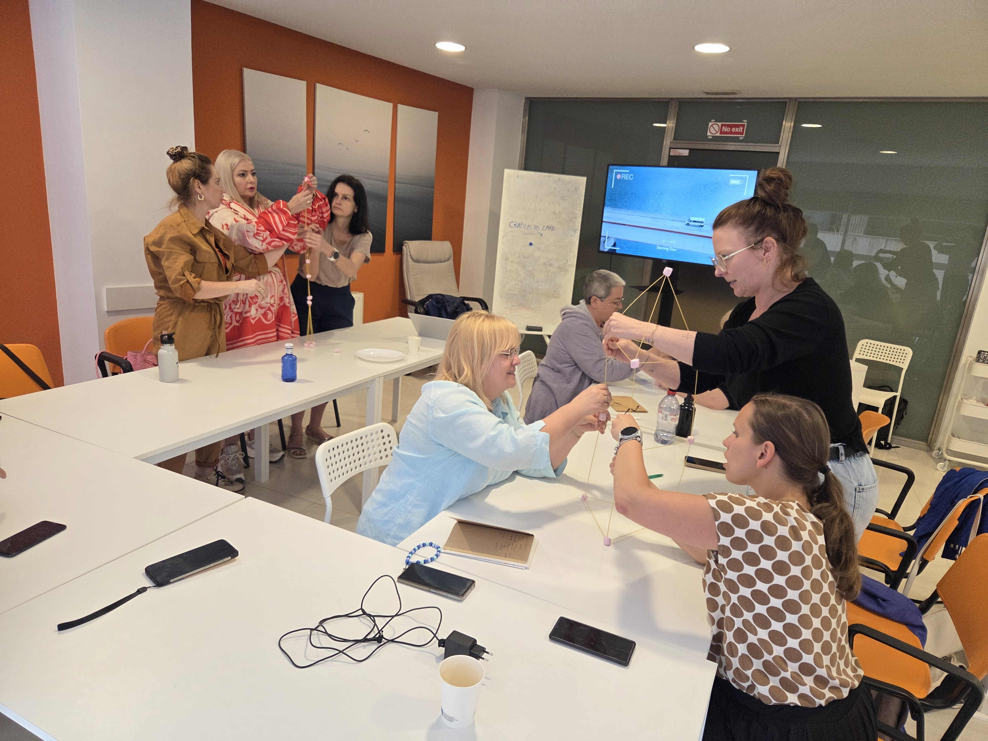

Slide 11
Our Contributions
Herbal Oil Project
SDG Posters & Banners
ECO Maps
Cultural exchange and peer learning

Slide 12
Reflections
What we learned:
Importance of everyday eco habits
Power of international teamwork
Interactive ways to teach sustainability

Slide 13
How Can Our School Act?
Create a Student Eco Committee
Practice Upcycling
Integrate SDGs into lessons
Celebrate environmental days
Start sustainability discussions on campus

Slide 14
Resources
Padlet Project: https://padlet.com/caracolasblancas/eco-may-2025-7vdbpb0e2ed0hd68
SDG Board Game: https://go-goals.org
Story of Stuff: https://www.storyofstuff.org
Visit Valencia: https://www.visitvalencia.com
Fashion Revolution: https://www.fashionrevolution.org/whomademyfabric/
UN Climate Action: https://www.un.org/en/climatechange/
Sustainability Pillars: https://sustainability-success.com/three-pillars-of-sustainability/
Megatrends Tool: https://knowledge4policy.ec.europa.eu/foresight/megatrends-engagement-tools_en
Ecosia Search Engine: https://www.ecosia.org

Slide 15
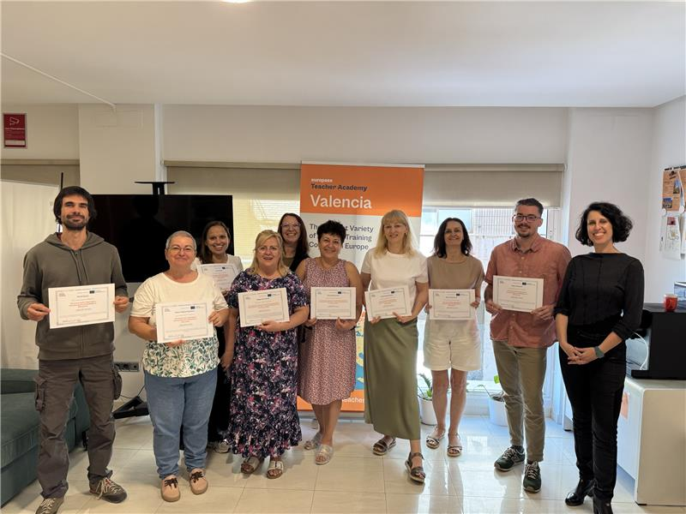
Thank You!
Let’s make our school more sustainable together!
#EcoMay2025 #SDGs #ErasmusPlus

